Slide 1
Dynamics of Pressure Measurement Systems
Peter Johansen, PhD
Associate professor

Slide 2
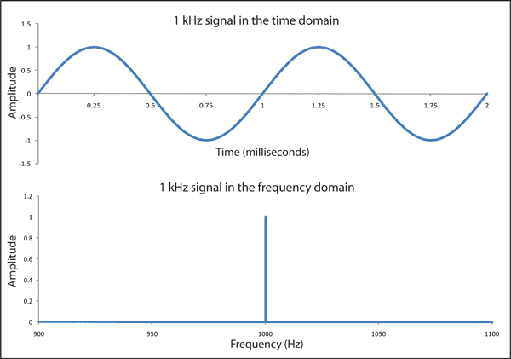
Time and frequency description

Slide 3
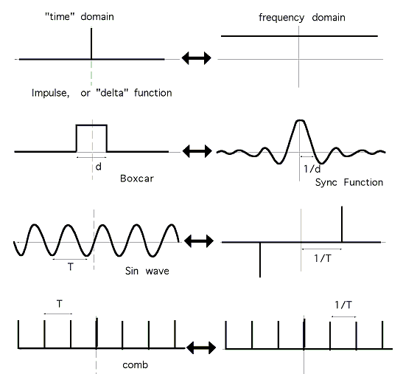
Time and frequency pairs

Slide 4
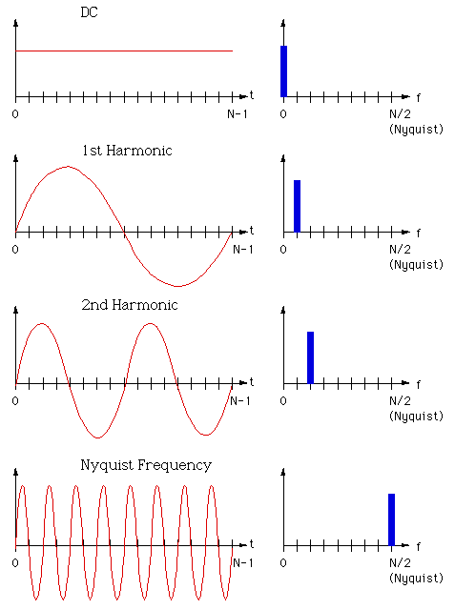
Harmonic components

Slide 5
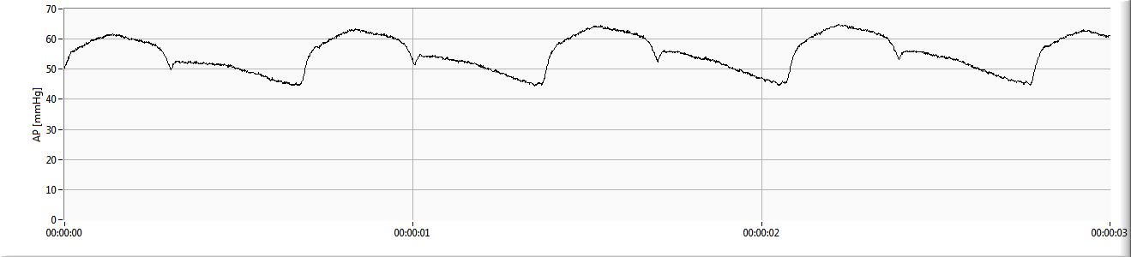
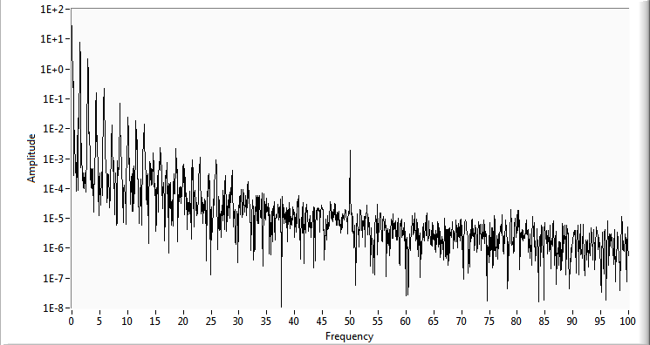
Arterial pressure waveform (analysis)

Slide 6
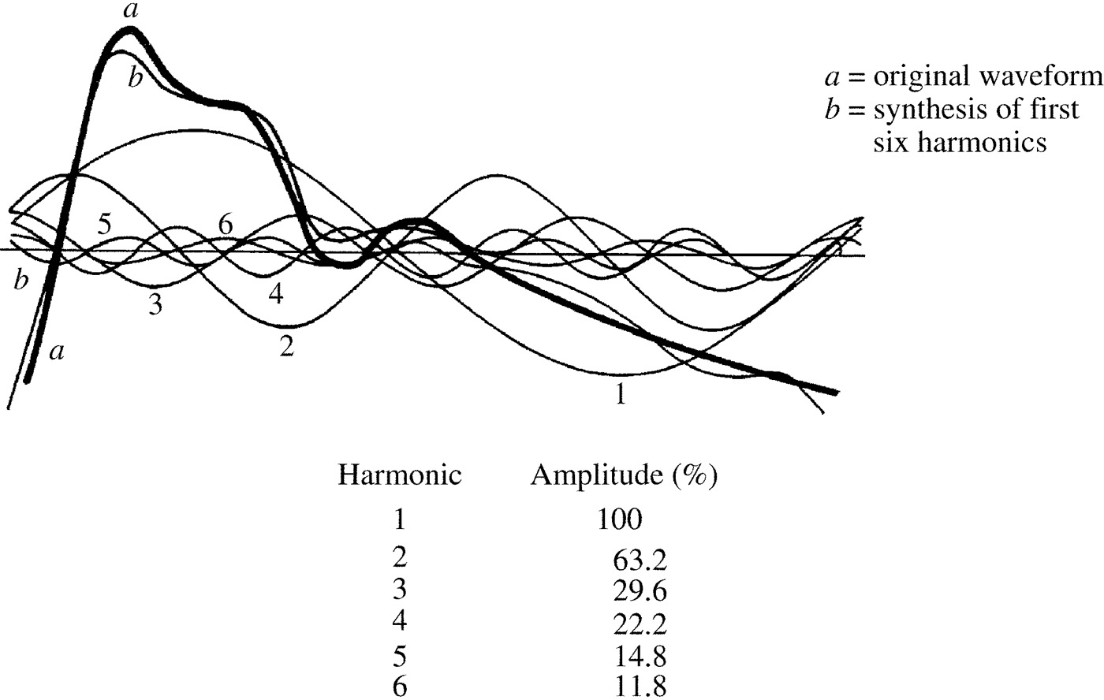
Arterial pressure waveform (synthesis)

Slide 7
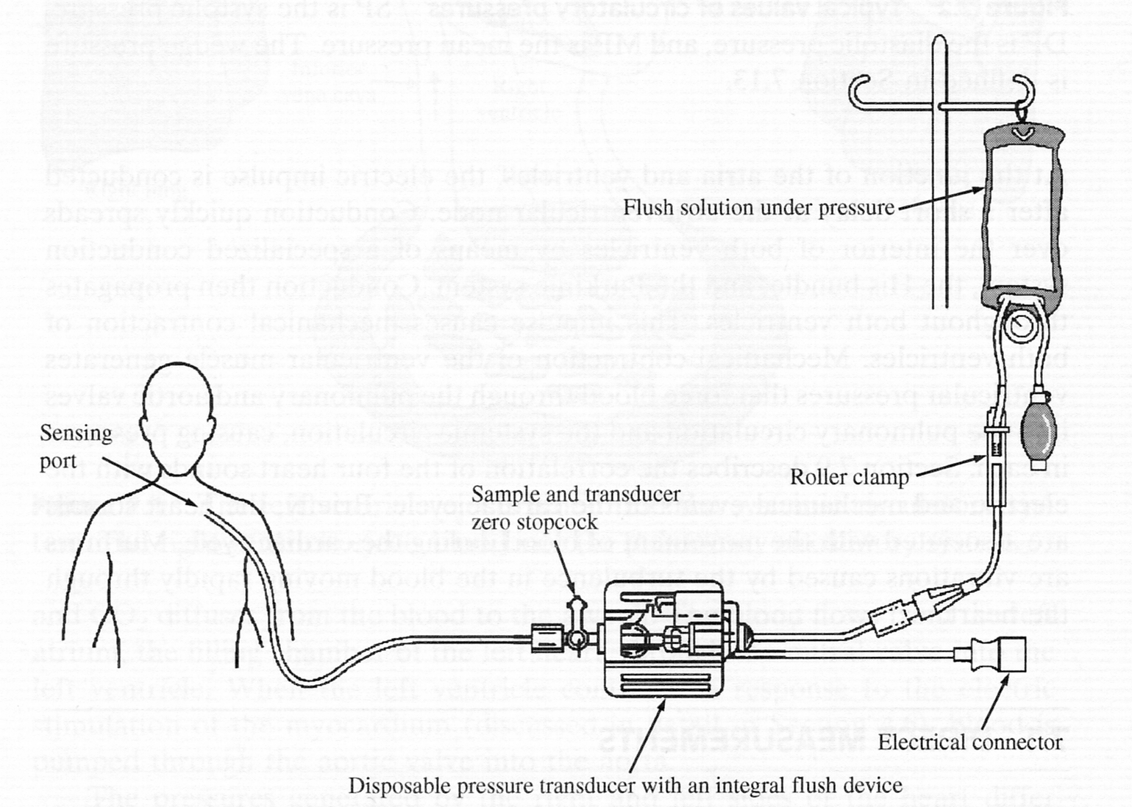
Fluid filled pressure catheter
Dynamic requirements
Dynamic properties

Slide 8
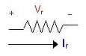
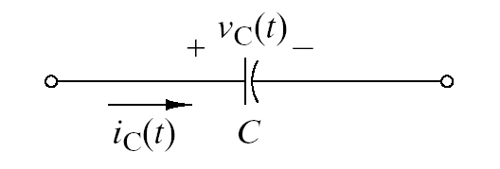
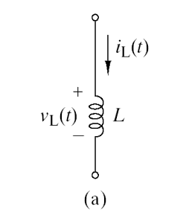
Modelling the fluid filled catheter
Resistor:
Capacitor:
Inductor:

Slide 9
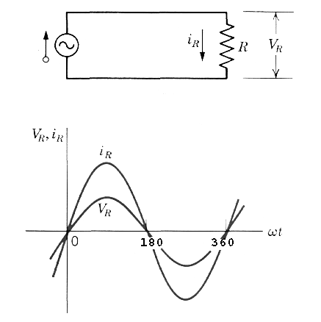
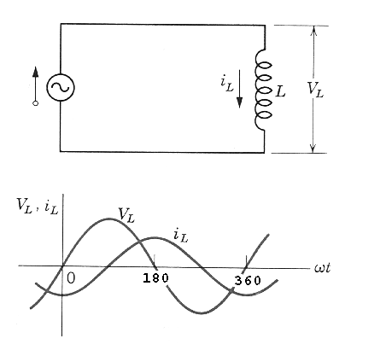
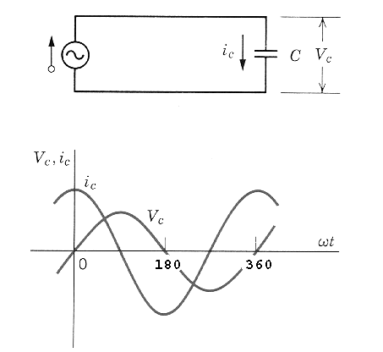
Electrical components

Slide 10
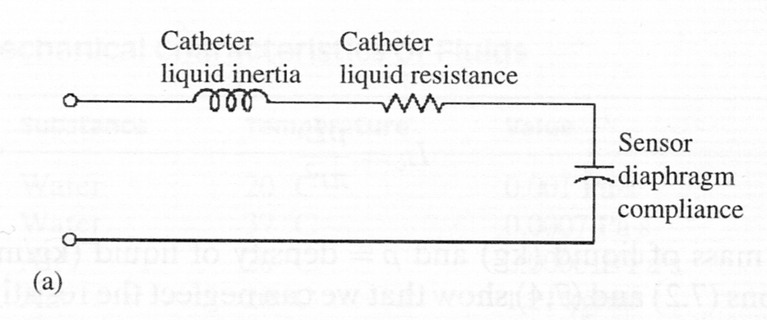
Analogous circuit equivalent
Describes the dynamic properties

Slide 11
Inductor (liquid inertia)

Slide 12
Resistor (liquid resistance)

Slide 13
Capacitor (compliance)

Slide 14
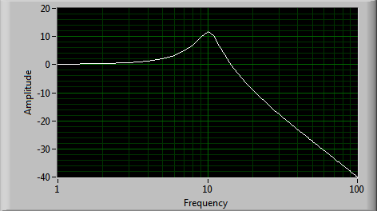
Second order low pass system
20logQ
ω₀

Slide 15
Equivalent circuit
20logQ
ω₀

Slide 16
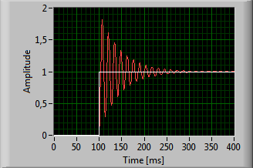
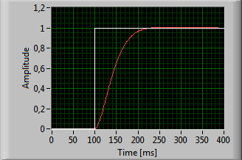
Q ~ quality factor
High Q
Low Q

Slide 17
Catheter transfer function

Slide 18
Catheter transfer function w/ and w/o a bubble

Slide 19
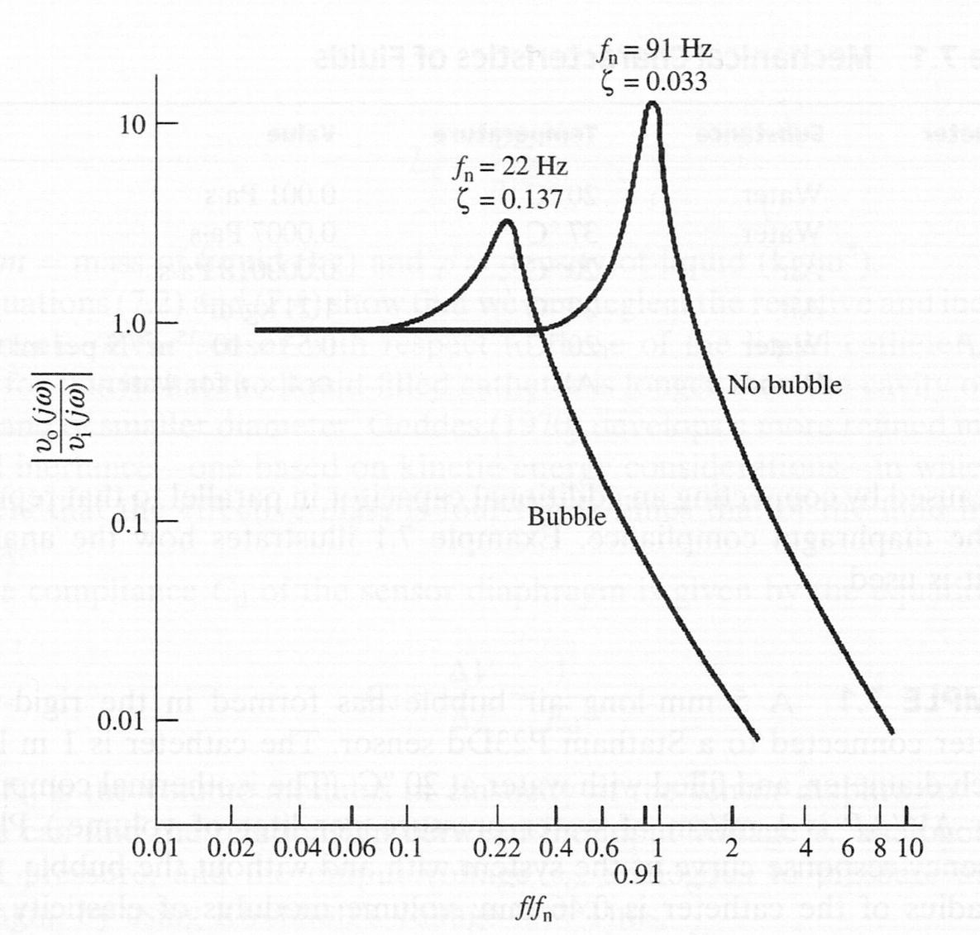
Catheter transfer function w/ and w/o a bubble
Lower bandwidth but same DC gain

Slide 20
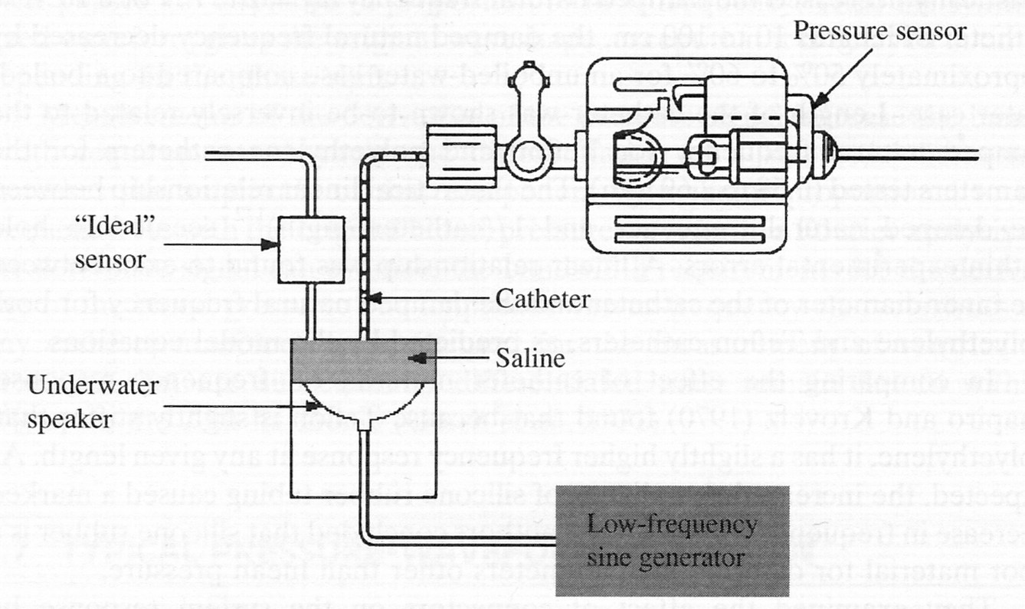
Frequency response

Slide 21
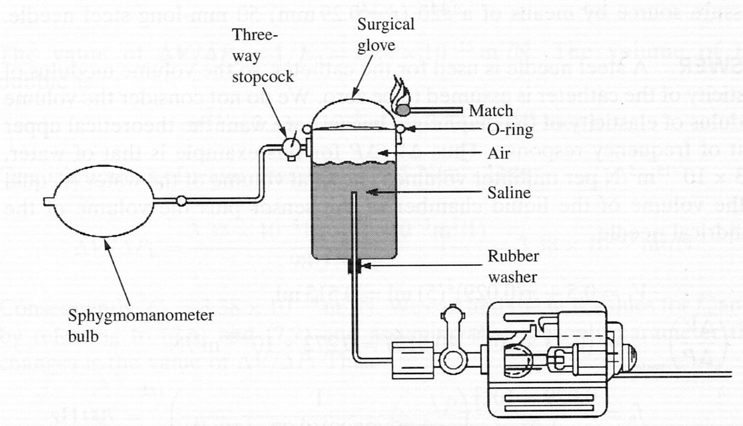
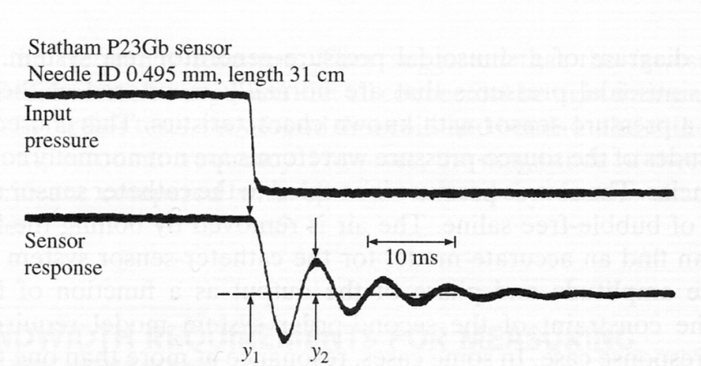
Frequency response

Slide 22
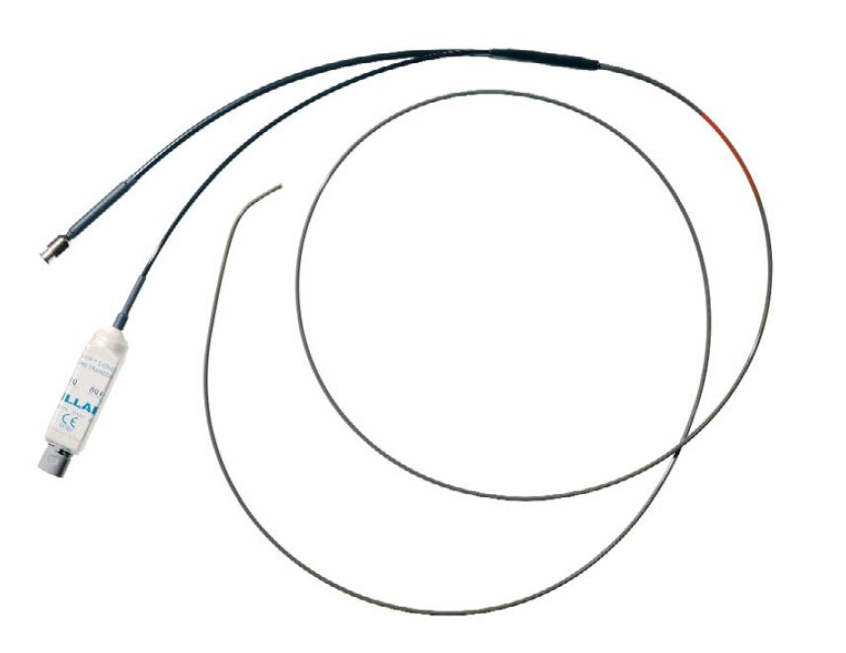
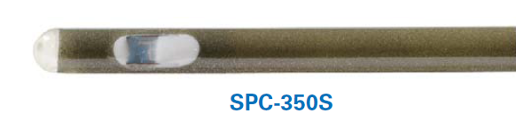
Micro-tip pressure catheters

Slide 23
Various effect - observed in time domain

Slide 24
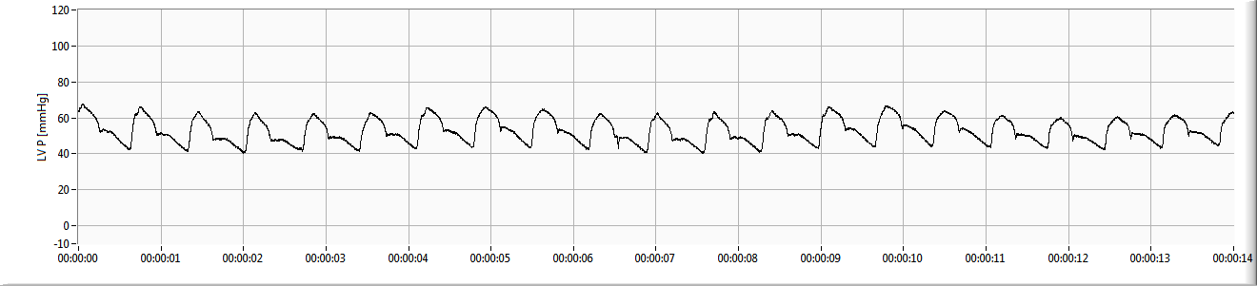
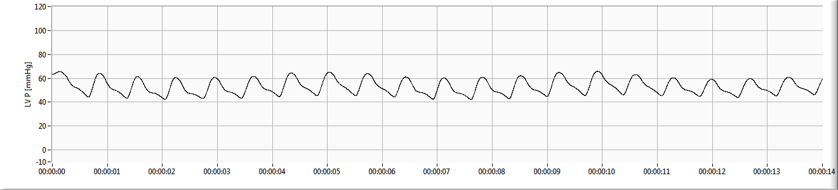
Normal vs. reduced bandwidth

Slide 25
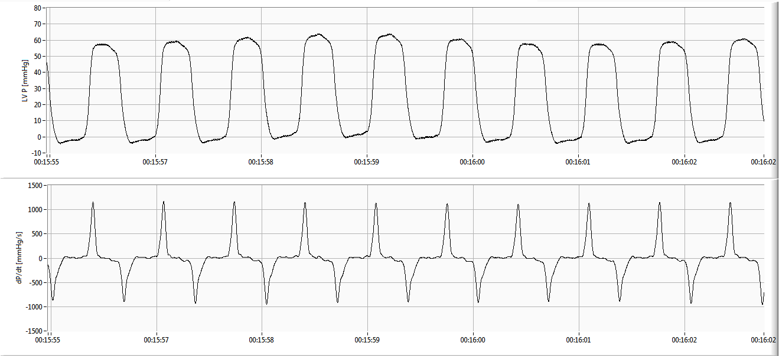
Time derived properties normal

Slide 26
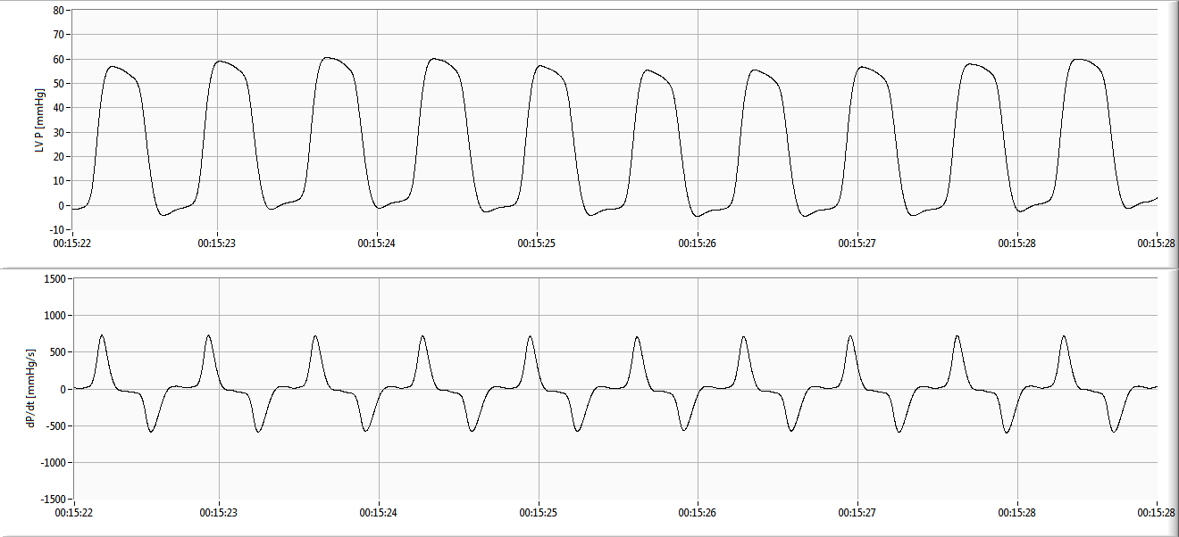
Time derived properties bandwidth reduction

Slide 27
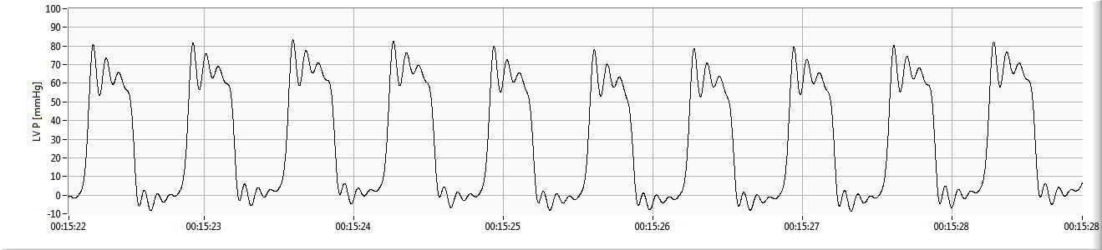
Under-damped waveform

Slide 28
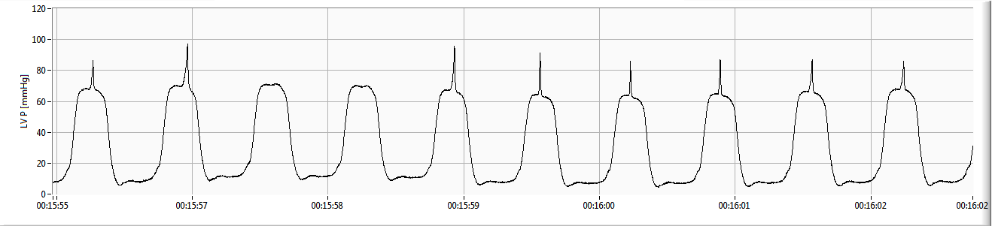
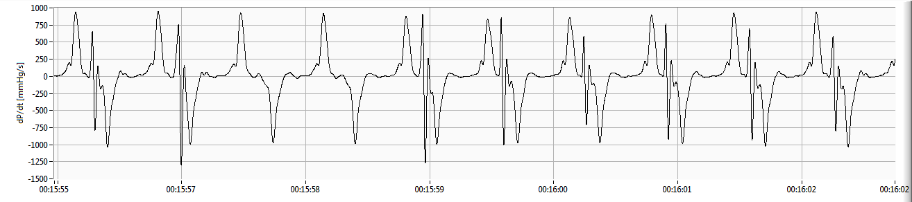
Catheter whip distortion

